Slide 1
AUCTION WARS
Made By: HARSH SHARMA (016)
NAMAN MALIK (027)
MCA 4th semester Shift: Morning

Slide 2
PURPOSE
Our main purpose for this project is people invest their money to get maximum profit and knowledge about our online auction system.
Here all type of user can go and analyses the data of different field and get maximum profit for future investment.

Slide 3
OVERVIEW
Online auction however is a different business model where the items are sold through price bidding. Usually bidding have start price and ending time. Potential buyers in auction and the winner is the one who bids the item for highest price.
For buying product online user have to provide his personal details like email address, mobile number etc. Only the valid user will have authority to bid. This prevents various frauds according in online shopping.
We treat the fraud detection.
This web application have interactive user interface.

Slide 4
SYSTEM REQUIREMENTS
Desktop/Laptop
(Windows or MAC or Linux Operating system )
Working internet connection
Ram 4 GB HDD space 250 GB

Slide 5
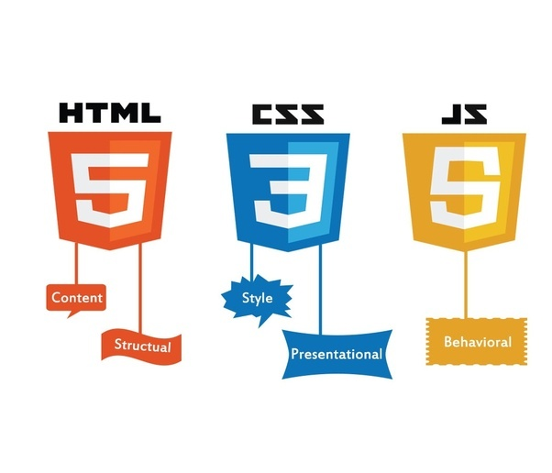



TECHNOLOGY USED

Slide 6
UNIQUE SELLING POINT
Convenience : The primary benefit to searching for a product by using an online auction is convenience. As a bidder, you can make offers no matter your location.
Open 24/7 :The second huge benefit of using online auction sites to buy your product is that you can place offers at all hours of the day.
Choices, Choices, Choices : A final benefit to looking for your perfect product online is the number of options you will have.

Slide 7
LOGIN
Each Customer/Seller is assigned a unique Id and password for their account Example : abc@gmail.com Password: #qwerty123
After login (Authentication and Validation) the user can access information regarding the products on which he can make bid.
Admin has separate login module.

Slide 8
CUSTOMER MODULE
Customer Register : customer will be provided with a personal account through registration
Customer Login : Login to the system with valid username and password.
Auction Products : Only verified customer can able to view auction product gallery, bidding for product and buy product.

Slide 9
SELLER MODULE
The seller module includes different sellers who wish to sell their products. A seller can add or delete different items. The different functionalities for seller are -
Can add a new a product
Can delete a product
Can place new offers to the product

Slide 10
ADMIN MODULE
The administrative module includes an admin who acts as an intermediator between seller and the customer.
Admin Login: Login with authorized username and passwords.
Verify Customers & Sellers : The Administrator verifies new users when the online auctioning also approve authorized seller after registration.
Delete Seller : If the admin feels all the products from particular seller mostly are not trusted he can also remove the seller and his related products.
Block Fraud Customer : Administrator can delete an account when any of the user leave the auctioning organization and permanently blocks the customer if fraud.

Slide 11
Thank you & Regards

